Slide 1
Vistec EBPG Software Training
Last Updated 10.20.14

Slide 2
EBPG Wiki
http://wiki.umn.edu/EBPG
Server connection software, SOPs, tutorial videos, etc.
Updated frequently; check back (or ask) if something isn’t there that should be

Slide 3
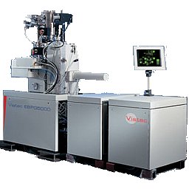
Electron Beam Lithography
The transfer of a CAD pattern to a substrate by “writing” with a focused beam of electrons
An electron beam is much smaller than a photon, so extremely high resolution is possible

Slide 4
Electron Beam Lithography (vs. optical lithography)
Advantages
Highest resolution of mainstream litho. technology
Flexibility (no mask required)
Simplified resist processing
Disadvantages
Proximity effect
Exposure needs to be done in vacuum.
Substrate charging/damage
Throughput!

Slide 5
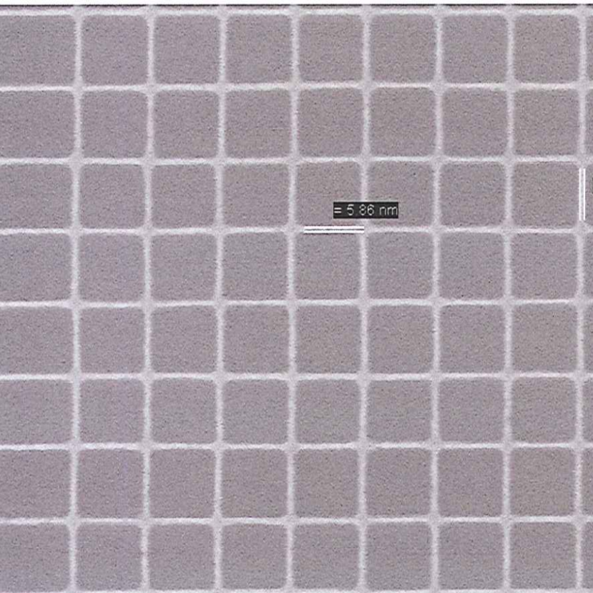
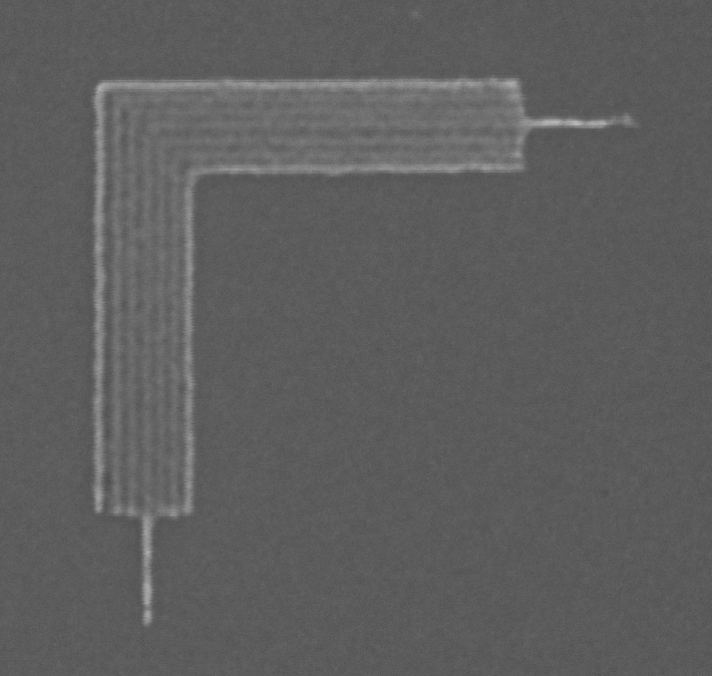
EBL Resolution
6 nm
4.5 nm
6 nm lines fabricated in HSQ on the UMN Vistec EBPG5000+ EBL system
9-nm-pitch nested-L test structure, fabricated in HSQ on a Raith-150² EBL system (courtesy Raith GmbH)
1 nm ≈ 10 atoms!!!

Slide 6
Basic EBL Workflow
CAD design of pattern
Your
computer
Upload pattern
CAD server
(ebpg.mnc.umn.edu)
Fracture pattern
(LayoutBEAMER)
Generate job file
(CJOB)
Vistec
(b039.mnc.umn.edu)
Execute job/expose pattern

Slide 7
General Scope
Basic system connectivity and commands
LayoutBEAMER overview
Cjob/exposure overview

Slide 8
Logging into CAD server
Locally
Server is located in PAN 250 next to the door
Use USB sticks or cloud storage to transfer files
Remotely
VNC (preferred): Basically makes a window on your computer a “virtual monitor” on the server
SSH: Can be used for text-based logins, or graphically if you have an X server installed on your computer
Also necessary for starting your VNC console!
SFTP: Good for moving files back and forth between your machine and the server

Slide 9
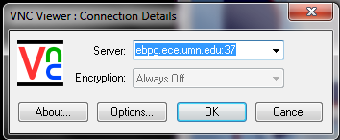
Using VNC
Enter the server name, a colon, and your display ID (e.g. ebpg.mnc.umn.edu:37)
Your display ID is contained in the email you receive when your account is activated
Can also use the command showvnc in PuTTY to display your desktop ID if you forget it

Slide 10
Starting Your VNC Server
Log into ebpg.mnc.umn.edu via SSH
See software documentation for details
Type the command crank at the prompt to start your VNC server
Keep your SSH window open for as long as you use VNC
When finished with VNC, exit the SSH session by typing ‘exit’ or CTRL-D (don’t just close the window)

Slide 11
General Scope
Basic system connectivity and commands
LayoutBEAMER overview
Cjob/exposure overview

Slide 12
Basic EBL Workflow
CAD design of pattern
Your
computer
Upload pattern
CAD server
(ebpg.mnc.umn.edu)
Fracture pattern
(LayoutBEAMER)
Generate job file
(CJOB)
Vistec
(b039.mnc.umn.edu)
Execute job/expose pattern

Slide 13
Exposure Strategy
Define a shape
Fracture the shape to be exposed into trapezoids
Split trapezoids into pixels
Write each trapezoid by deflecting the beam to each pixel
Problem: Beam can only be deflected ~250um in any direction.

Slide 14
Writing Large Patterns
Divide pattern up into write fields
Move stage to place beam at the center of write field
Use beam deflectors/blanker to write section of pattern in the write field
Move stage to next field and repeat
Field stitching: accuracy with which the fields line up at the boundaries
(Generally <25 nm off in high-end EBL systems)

Slide 15
Exposing a Pattern
Exposure is defined by electron dose (deposited charge per unit area).
Not fundamental! Same dose can give very different final patterns depending on voltage, beam size, etc.
Number that matters is deposited energy per unit volume of resist, but this is hard to calculate
I: beam current
t: pixel dwell time
x: step/pixel size

Slide 16
Proximity Effect
Pattern distortions due to electron scattering.
2 types: forward scattering and backscattering
Low Voltage
Significant forward scattering, causing fine features to “blur”.
High Voltage
Forward scattering reduced, but backscatter range is increased, making it possible for shapes far from one another to be affected
beam
resist
backscattering (β)
forward
scattering (α)
substrate

Slide 17
Proximity Effect
Proximity Effect
Areas with > 100% Dose
“Drawn” pattern
Extra exposure due to scattering

Slide 18
Proximity Effect Correction
Simple explanation: use lower doses in dense regions and higher doses in isolated regions to counter cooperative exposure
Highest dose
Low dose
100 μm
Higher dose

Slide 19
Purpose of LayoutBEAMER
Turns your CAD files into EBPG-readable lists of polygons (“fracturing”)
Divides pattern into mainfield and subfields
Performs (optional) proximity effect correction
Miscellaneous other functions

Slide 20
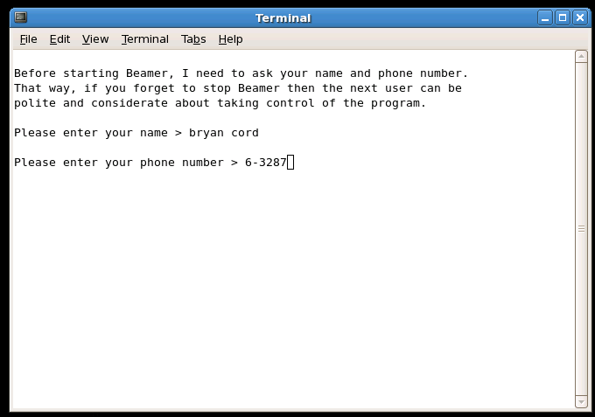
Starting LayoutBEAMER
Our BEAMER license is single-user, please be considerate!

Slide 21
(interactive Beamer demo goes here)

Slide 22
General Scope
Basic system connectivity and commands
LayoutBEAMER overview
EBPG/CJOB overview

Slide 23
User Environments
Only one permanently logged-in linux user (“pg”)
Each tool user has an environment they can switch to with: ce <username>
Environment has several subdirectories
Jobs: Contains .job and .cjob files
Patterns: Contains .gpf files referenced in job files
Log: Contains log files created during writes
No isolation between users– don’t mess with other peoples’ files!

Slide 24
Basic EBL Workflow
CAD design of pattern
Your
computer
Upload pattern
CAD server
(ebpg.mnc.umn.edu)
Fracture pattern
(LayoutBEAMER)
Generate job file
(CJOB)
Vistec
(b039.mnc.umn.edu)
Execute job/expose pattern

Slide 25
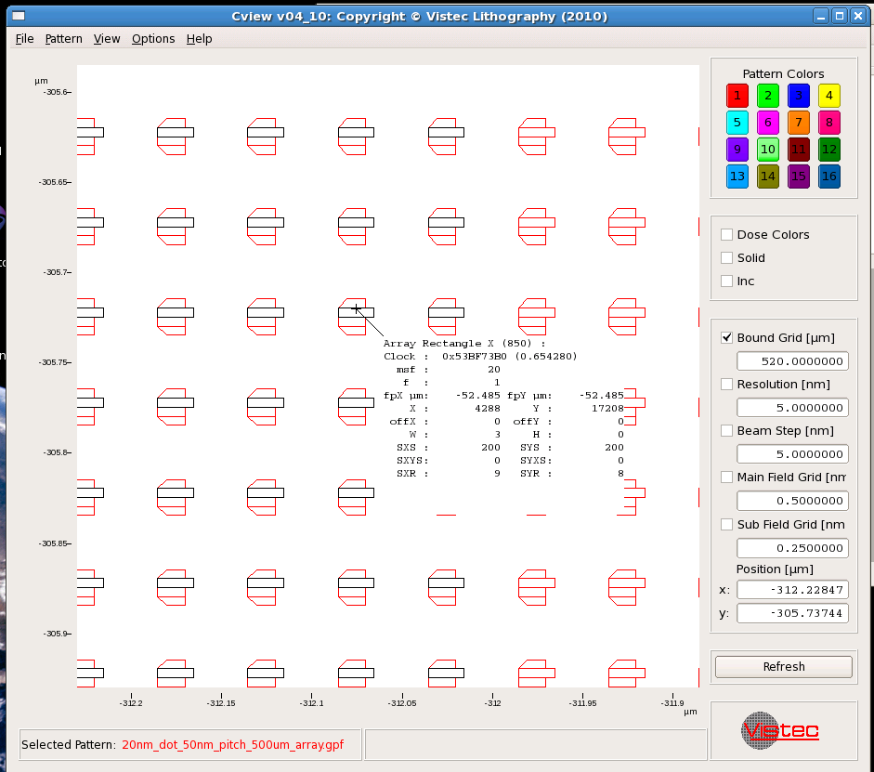
EBPG Software: CView
Fractured (.gpf) file viewer
Useful for checking doses, fracturing errors, etc
Available on CAD machine as well as EBPG

Slide 26
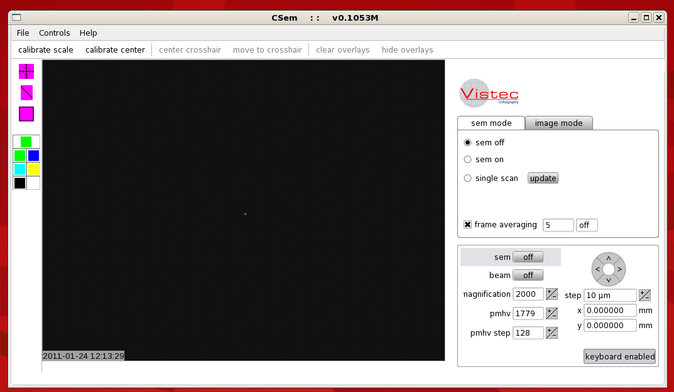
EBPG Software - CSem
SEM off: shows deflector position in real-time
SEM on: allows (limited) imaging of marks etc.
Also useful for getting absolute coords

Slide 27
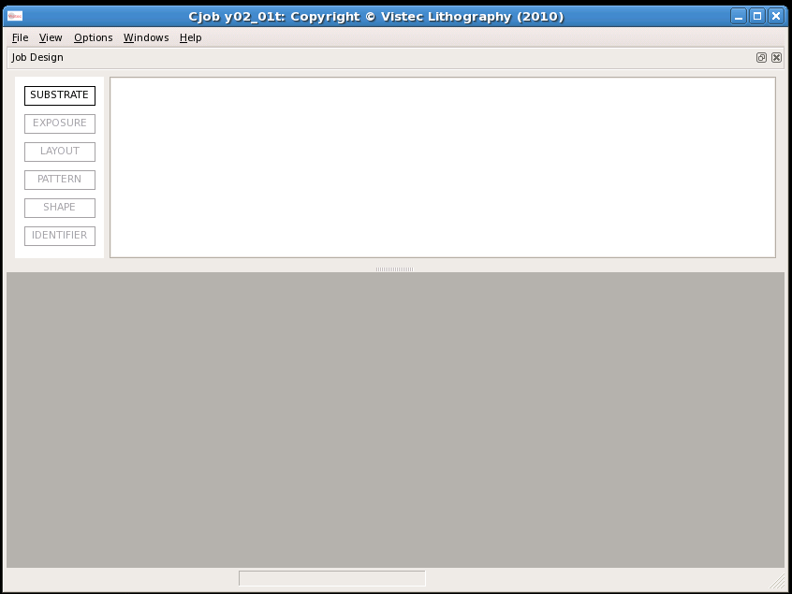
EBPG Software - CJob
GUI based exposure script creator
Notes:
CJOB is a graphical user interface to create and visualize a layout of patterns.
It does not actually run the tool, but creates a script that is to be run to expose the design.

Slide 28
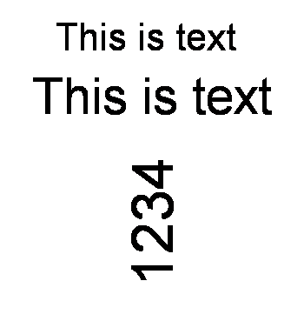
Design Objects
Exposable Objects
Pattern
Shape
Identifier
Notes:
Of the exposable (need a beam) objects, only the pattern object needs a separate data file. Both shape and identifier can be written without a data file.
Types of shapes available: rectangles, borderlines and crosses.

Slide 29
Design Objects
Container Objects
Substrate
Exposure
Layout
Notes:
Substrate = physical substrate
Exposure = Logical grouping of exposable elements for a particular kV.
It is also used for global alignment of the exposure job and can optionally perform checks before the actual exposure. (field distortion, current distribution etc.)
Layout = A container consisting of cells. These cells may contain other elemenets including any exposable object and other layouts (!!!!).

Slide 30
(interactive CJOB demo goes here)

Slide 31
Exposure Parameters?
What values should I use for…
Step size?
Beam current?
Electron dose?
Picking the right values for these is the key to getting maximum performance from the EBPG

Slide 32
Definitions
Spot Size: The physical width of the electron beam during your write. Indirectly set by beam current used to write.
AKA: Beam diameter, beam width
Pixel Size: The width of the pixels in your pattern file. Directly set by fracture settings in LayoutBEAMER
AKA: Resolution, Beam step size, Pixel width, pixel diameter.

Slide 33
Step Size Considerations
Line-edge roughness
For best results, your smallest feature should be at least 5 pixels wide after fracturing
You can cheat this if LER isn’t a major issue
Spot size compatibility
To get the largest possible process window, pixel size should be ~60% of the beam spot size you’re using
Spot size is set by beam current; see chart online
Anything between 10-100% of spot size will work, but feature sizes will be much more dose-dependent

Slide 34
Beam Size and Pixel Size
Beam width too small for pixel width, pattern not fully exposed
Beam width too large for pixel width, pattern washed out
Good pixel/beam size ratio, pattern is evenly exposed

Slide 35
Beam Current Considerations
Spot size
Spot size is directly proportional to beam current
Pick a current to get a spot ~2X the size of your pixel diameter, if possible
If you need low current/large spot, beam can be defocused in CJob
Throughput
Higher beam current will speed up your write
Be careful not to exceed 50 MHz pixel clock limit!
Available beam currents:
100 pA – 300 nA (300 μm aperture)
1 nA – 400 nA (400 μm aperture)

Slide 36
Theoretical Spot Sizes (100 kV)
Beam current (nA) | 300 μm aperture | 400 μm aperture
0.1 | 5 nm | 7 nm
0.5 | 5 | 7
1 | 5 | 7
5 | 5 | 10
10 | 16 | 15
50 | 40 | 30
100 | 60 | 50
Can always use the mss command to verify the spot size of a beam.

Slide 37
Dose Considerations
Resist sensitivity
Dose needs to be high enough to expose resist, but low enough that scattered electrons don’t wash out the pattern
Critical dose is very geometry-dependent; can vary by more than an order of magnitude
Always do a dose array when running a new pattern!
Throughput
Lower dose = higher throughput, obviously
Use a more sensitive resist/development process to speed up your write, if needed

Slide 38
Aligned Writing
What if we want to accurately place a pattern on top of a pre-existing structure?
Use alignment marks in the first pattern as a reference for the second
EBPG5K+ has an overlay error of <50 nm if you do everything right

Slide 39
Alignment Mark Design
Best markers are rectangles
Crosses can be used, but aligning is harder
Size: 1-100 μm, larger is better (~10 μm is typical)
Notes:
Pattern markers: An alignment is being done before every pattern.

Slide 40
Terminology Clarification
Mark Definition: The description of what your mark looks like in the software (created from the command line and referenced in job files)
Alignment Mark: The actual, physical mark present on your substrate, fabricated in a previous process step.
Your marks and mark definitions need to match for alignment to work!

Slide 41
Hierarchal Alignment
Global (Exposure) marks
Local (Layout) marks
Local (Pattern) marks
More marks = more consistent alignment!
Mark references can be reused at multiple levels

Slide 42
Alignment Mark Tips
Use several levels of marks (global, layout, pattern)
More closely spaced marks = better overlay accuracy
Creating pattern-level marks and reusing them up the hierarchy is an easy way to do this
Try to surround the pattern you’re aligning to with marks
The “generate” button is bad at this; avoid it
Use good mark materials/processes
See guide online for more

Slide 43
Next Steps
Read through the SOP online
Other parts of the wiki may be useful too
Download software from Wiki, make sure you can connect to the server
Experiment with creating jobs/patterns in LayoutBEAMER and Cjob
Register for hardware shortcourse
No sample needed for this, we’ll do a dummy write

